Slide 1
NLP Automation
Dr. S VIJAY KUMAR - MENTOR
19BTRCR005 – M R NAVEEN KUMAR
19BTRCR018 – A RISHAB VANIGOTHA
19BTRCR023 – K V ABHIRAM
19BTRCR024 – KEERTHI U S
19BTRCR026 – MILAN HUNDIA JAIN

Slide 2
TABLE OF CONTENTS
INTRODUCTION
01
02
OBJECTIVES
ABSTRACT
03
04
LITERATURE SURVEY
EXISTING SYSTEM
05
06
PROPOSED SYSTEM
METHODOLOGY
07
08
RESULTS

Slide 3
INTRODUCTION
A computer program's capacity to comprehend natural language, or human language as it is spoken and written, is known as natural language processing (NLP). It is a part of machine intelligence (AI).
Natural Language Processing (NLP) is a field of study focused on allowing computers to understand, interpret, and generate human language.
The automation of NLP tasks has become increasingly important as the amount of unstructured text data continues to grow.

Slide 4
INTRODUCTION
The development of web interfaces and tools that simplify and automate NLP tasks is crucial in allowing users to analyze and understand their data without the need for extensive technical knowledge.
NLP is widely used for applications like NER(Named Entity Recognition), Text Classification, Text Generation, Text Mask Prediction etc.
NLP requires a lot of tedious tasks to be done. It requires a lot of effort and time.

Slide 5
OBJECTIVES
To DESIGN
To PROVIDE
To OPTIMIZE
To MAKE
Web interface for NLP tasks.
User-friendly environment for performing NLP tasks
NLP Workflow for efficiency and effectiveness
NLP more accessible to a wider audience by reducing need of expertise.

Slide 6
ABSTRACT
Our project aims to provide assistance for the developers and organizations performing Natural Language Processing.
We are proposing the idea of creating a web interface that automates the processing of natural languages and performs NLP(Natural Language Processing) tasks.
The interface would also perform modelling of the processed data.
We will be making use of SOTA(State Of The Art) models.

Slide 7
LITERATURE SURVEY
S.NO | NAME | AUTHORS & YOP | SUMMARY
1 | An Examination System Automation Using Natural Language Processing | Manjusha Pandey Indrashis Das Siddharth S. Rautaray bharat sharma YOP - 2020 | In this study, they attempt to automate the process of scoring answers. Essentially, a descriptive online examination system is where the data comes from. The data is analyzed and the model assigns marks to the answers provided. The back-end is written in Python, and NLTK and the NLTK library is used for natural language processing and database purposes.
2 | A Survey on Text Pre-Processing & Feature Extraction Techniques in Natural Language Processing | Ayisha Tabassum, Dr. Rajendra R. Patil YOP - 2020 | This study discovered that text preprocessing methods are a significant factor in raising the accuracy of any method for text-based machine learning. The sequence of The result is influenced by the NLP pipeline, which is made. It is found that StopWords removal, punctuation, and tokenization are the popular and effective text formatting techniques

Slide 8
LITERATURE SURVEY
S.NO | NAME | AUTHORS & YOP | SUMMARY
3 | Automation in Systematic, Scoping and Rapid Reviews by an NLP Toolkit: A Case Study in Enhanced Living Environments | Eftim Zdravevski, Petre Lameski, Vladimir Trajkovik, Ivan Chorbev, Rossitza Goleva, Nuno Pombo & Nuno M. Garcia YOP - 2019 | In this paper, they present an NLP toolkit for surveying scientific articles and trend analysis meta-studies. By leveraging NLP, it facilitates a robust and comprehensive eligibility and relevance analysis of articles. The framework is able to analyze the abstracts of over 70000 articles automatically.
4 | Natural Language Processing approach to NLP Meta model automation | Mohammad Hossein ,Hassan B. Kazemian, Karim Ouazzane, Chris Chandler YOP - 2018 | An intelligent software has been developed which is able perform as a competent NLP practitioner or psychologist. Results by the software were compared to the obtained results by the practitioner. A more efficient performance of the software, with a high level of accuracy and reliability, was observed.

Slide 9
EXISTING SYSTEM
The existing system is essentially a Python library that does automated exploratory data analysis, data cleaning and preprocessing for machine learning and natural language processing.
It also offers widget-based data analysis, which gives a graphical user interface and allows users to do any function by just ticking a checkbox.
Word Analysis and Basic EDA Analysis are two forms of exploratory data analysis that are available

Slide 10
PROPOSED SYSTEM
This system performs the basic exploratory data analysis, text preprocessing, and models required for NLP.
It has the ability to create models through a web-based graphical user interface.
It just requires a dataset as input, and our web GUI outputs a dataset based on the user's option of word or phrase analysis.
The user does not need any prior coding knowledge.

Slide 11
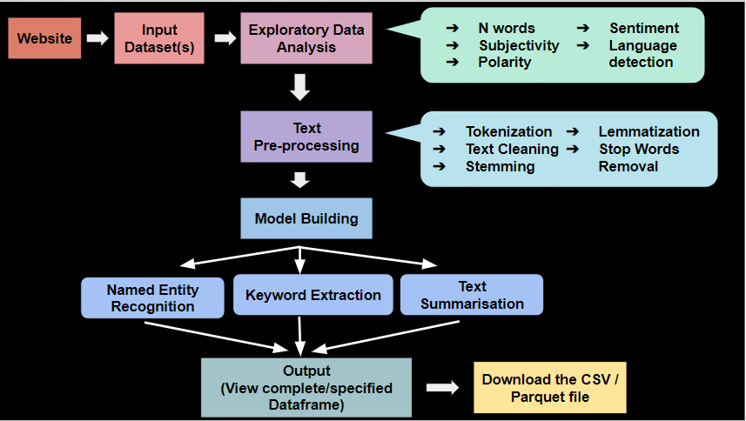
SCHEMATIC DIAGRAM

Slide 12
METHODOLOGY
We begin with loading the dataset file in csv format in the webpage.
We explore the selected text column using various exploratory data analysis techniques.
Then, we perform text processing like data cleaning , lexical analysis (tokenization, stop word removal, stemming, etc.,), followed by sentence level analysis (semantic, syntactic, pragmatic, and disclosure analysis).
After finishing the textual analysis, we perform Feature extraction where we extract useful features from the processed data.

Slide 13
Then, you can select a model for building out of given 3 models:
Named – Entity Recognition
Text Summarization
Key word Extraction
For model building we use Transformers , a type of neural network architecture that uses encoders and decoders with positional embeddings to process the language.
They have been shown to outperform recurrent neural networks (RNNs) on a variety of natural language processing (NLP) tasks, such as text classification, machine translation, question answering, and text generation
They have ability to capture long term dependencies in text and process the text parallelly
This section concludes with the creation of a user-friendly web-based interface that generates the desired output.

Slide 14
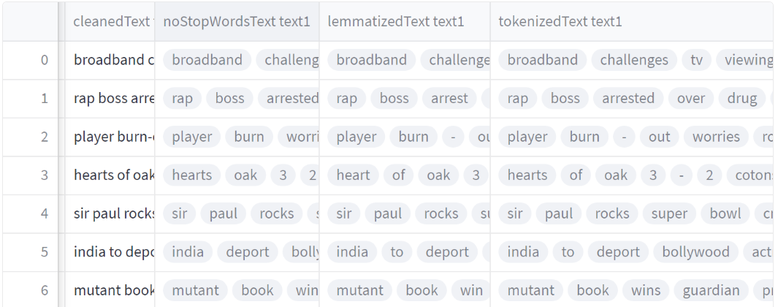
RESULTS
Fig: Text Preprocessing Tasks

Slide 15
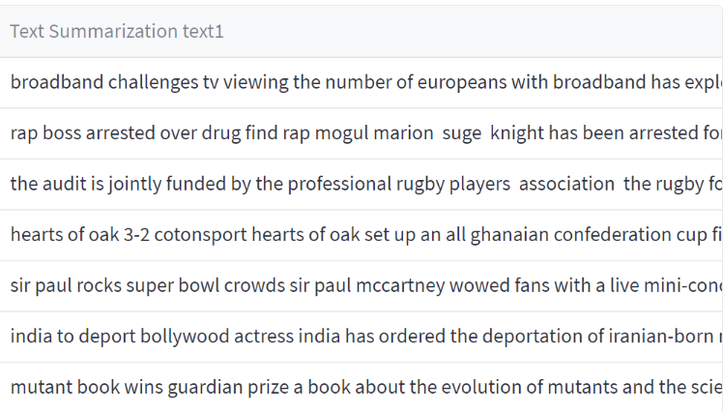
RESULTS
Fig: Text Summarization

Slide 16
CONCLUSION
Automation of natural language processing is an ongoing process that is becoming increasingly important as businesses strive to become more efficient and productive.
By automating natural language processing tasks, individuals and businesses can save time and resources while still delivering accurate results.
Automation helps to reduce the cost of human labour while improving the quality of results.
With the help of a Web-based interface one can effectively use automation to streamline their natural language processing tasks and improve the accuracy of their results.

Slide 17
REFERENCES
https://www.researchgate.net/publication/339406698_An_Examination_System_Automation_Using_Natural_Language_Processing
https://www.irjet.net/archives/V7/i6/IRJET-V7I6913.pdf
https://link.springer.com/chapter/10.1007/978-3-030-10752-9_1#Sec9
http://repository.londonmet.ac.uk/3447/1/Paper.pdf

Slide 18
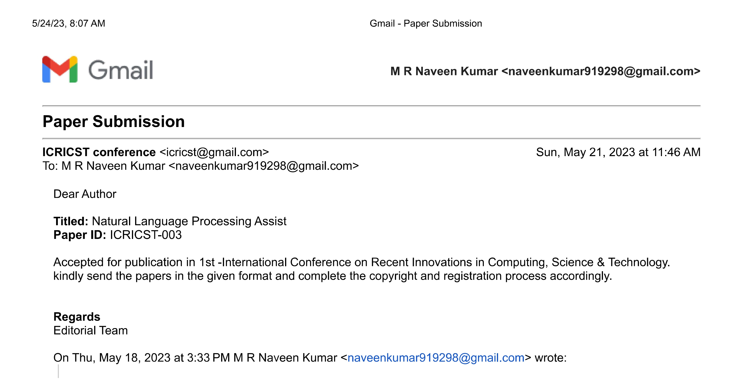
Publication Acceptance

